Slide 1



Child Support Guidelines Review Commission
2022

Slide 2

BEFORE WE START...
On behalf of all colleagues at the Human Services Department, we humbly acknowledge we are on the unceded ancestral lands of the original peoples of the Apache, Diné and Pueblo past, present, and future.
With gratitude we pay our respects to the land, the people and the communities that contribute to what today is known as the State of New Mexico.
Evening drive through Corrales, NM in October 2021.
By HSD Employee, Marisa Vigil

Slide 3
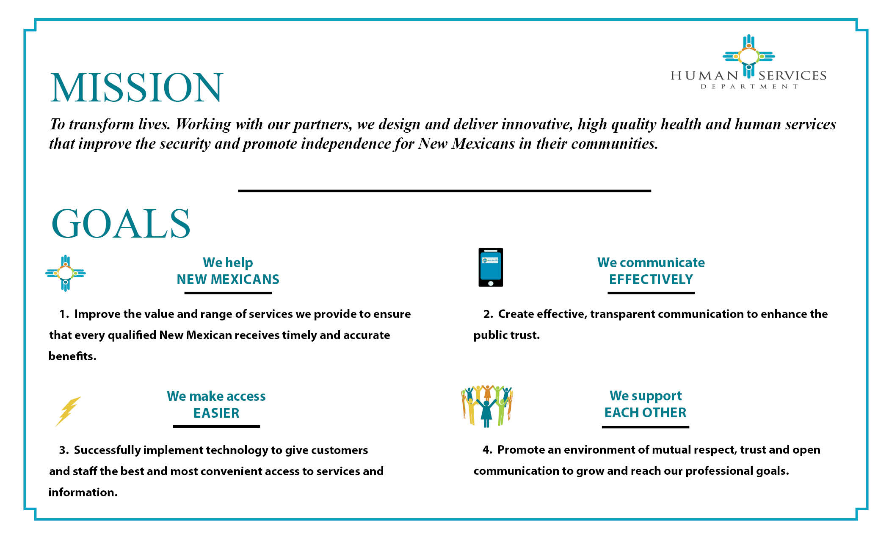

Slide 4
Meeting Agenda
Time | Agenda Item | Lead
10:00 – 10:05 | Welcome Roll Call Approve Agenda | Betina
10:05 to 10:30 | Action Items: CSED Modernization Efforts Enforcement Action Results Child Support Payment Sources Actual Hours Worked –National and Local Data $5 Medical Support | Betina
10:30 to 11:15 | Impact of Incorporating the Self-Support Reserve | Betina & Jane Venohr, Ph.D
11:15 to 11:30 | Public Input | Jill
11:30 to 11:55 | Commission Decision Items & Next Steps | Commission
11:55 to 12:00 | HSD Legislative Ideas Under Discussion | Kari

Slide 5
Commission members – Roll Call
Kari Armijo, Human Services Department Deputy Secretary
Betina McCracken, Child Support Enforcement Division (CSED) Acting Director
Wanda Martinez, Esq. Deputy General Counsel of CSED Legal Services
Sen. Antoinette Sedillo Lopez – New Mexico State Senator
Gina DeBlassie, Office of Governor, Health Policy Advisor
Teague González, Esq. Center on Law and Poverty
Johnny Wilson, Executive Director Father’s New Mexico
Judge Shannon Broderick Bulman, First Judicial District Court
Judge James T. Martin, Third Judicial District Court
Judge Jared Kallunki, Fifth Judicial District Court
Stephen Klump Esq., Domestic Relations Hearing Officer Second Judicial District Court
Investing for tomorrow, delivering today.
Notes:
CSED customers total is 207,782.
Sen. William Burt (R) – Chaves, Lincoln & Otero counties
Rep. Gail Armstrong (D) – Bernalillo County
Sen. Siah Correa Hemphill(D) – Catron, Grant & Socorro counties
Rep. Tara Lujan (D) – Santa Fe County

Slide 6

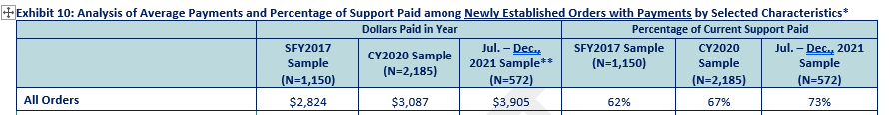
CHILD SUPPORT MODERNIZATION efforts
2021 SB 140 - Implemented child support guideline changes that reflect actual income, ability to pay, and reduced the “look-back period” to 3 years
  Took effect July 1, 2021
  Early data showing promise with 73% of new orders making monthly obligations. – Exhibit 10

Slide 7

CHILD SUPPORT MODERNIZATION efforts
Supporting, Training, and Employing Parents Up (STEPUp!)
  Partnership with Dept. of Workforce Solutions
    Job development
    Job Opportunities
  Pilot began in 2019
  Statewide in 2020
  Initiative to automate referrals in SFY23
  SFY 22 48% Success Rate of interviews resulting in job placements
STEPUp! Public Service Announcements
  TV & Radio
  English, Spanish & Diné

Slide 8
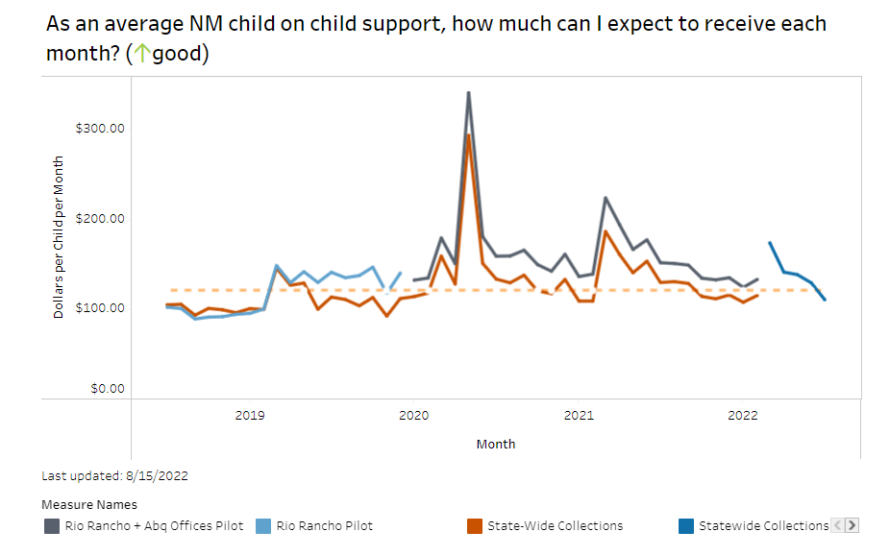
CHILD SUPPORT MODERNIZATION efforts
Online and By Phone Payment Options
  Pilot began in June 2020 went statewide Nov. 2020
  Exploring options to cover fees for debit/credit pymts.
E-Filing with the Courts
  Phased in all field offices by January 2021
Implemented Performance Measure Data Driven Processes Statewide in February 2022
    Used Organizational Change Management
    Evaluation will be conducted semi-annual
Online Child Support Enforcement System (CSES) Launched February 21, 2022
CSES Replacement/Modernization
  Leverage HHS 2020 efforts to modernize CSES
Electronic Document Management in Progress
Updated Child Support Unified Portal
Funding to implement Families First Distribution Rule Changes (Deficit Reduction Act (DRA))
  Effective January 2023

Slide 9
Focus on Establishment and Modifications
CSED has been focusing on Establishing new orders and modifying orders based on actual income and ability to pay
Resulting in less legal filings and enforcement actions

Slide 10
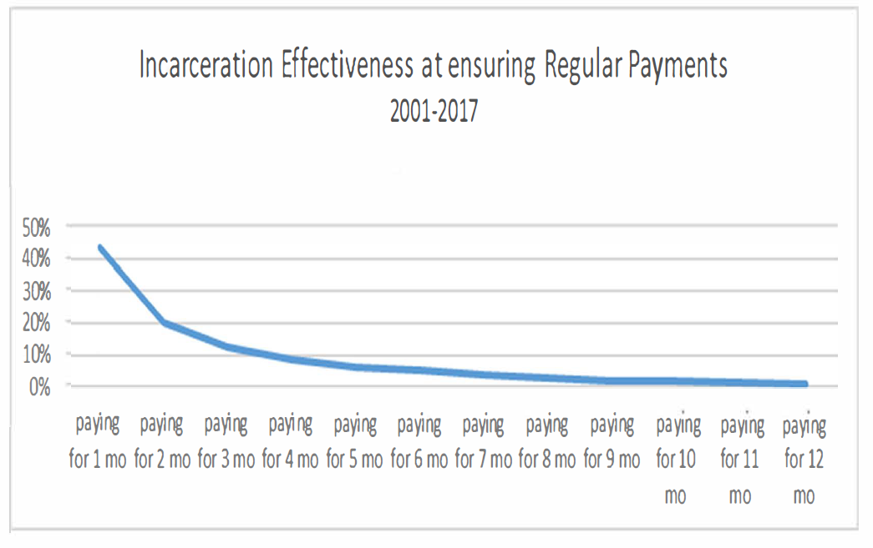
Enforcement action success
Orders to Show Cause may result in Bench Warrants for failure to pay child support
Bench Warrants or Arrests may result in one-time payments
CSED 2017 Study

Slide 11
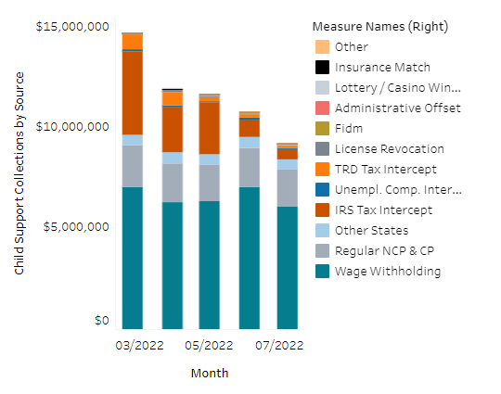
Child support collections & sources
SFY 2022 - $130.3M
HSD Scorecard Measures

Slide 12
Child support collections & sources
SFY 2021 - $147.5M

Slide 13
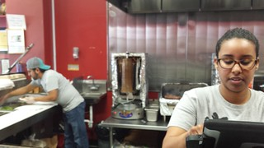

Actual Hours Worked – private industries
National Data
  Average 34.6 hrs. p/week
    30.1 hrs. p/week retail trade
    25.9 hrs. p/week leisure and hospitality industry
New Mexico
  Average 34.1 hrs. p/week (private non-farm payrolls)

Slide 14

History of $5 Medical Support Orders
2009 NM SB 57 - Amended the Mandatory Medical Support Act, Section 40-RC-3/4 NMSA 1978 to allow for cash medical support when health insurance is not available
  Federal regulations at that time required cash medical support to be ordered when private health insurance is not provided for minor children
The 2016 Federal Office of Child Support Enforcement (OCSE) Flexibility, Efficiency, and Modernization Act (FEM) Final Rule redefined Health Care Coverage to include private health insurance and public health care coverage and no longer required to seek cash medical support for those children who were covered by a public health plan such as Medicaid

Slide 15
Incorporating Self Support Reserve in guideline schedule
Self Support Reserve (SSR) considers the subsistence needs of obligated parents
  Custodian’s income does not increase the order – assumes CP’s income is $0
  2018 Commission recommended using the SSR and assume CP has no income when obligated parent’s income and # of children fall into the SSR., but didn’t make it into legislation
  Setting right-sized orders encourages employment in the formal economy instead of the underground economy
SSR example set @ Federal Poverty Guidelines (FPG) x NM price parity: Each parent earns $1,250 per month, order would be:
  $60 for one child or,
  $75 for two children
NM existing example: Each parent earns $1,250 per month for total $2,500 combined income, order would be:
  50% $436 = $218 for one child or
  50% of $663 = $332 for two children

Slide 16
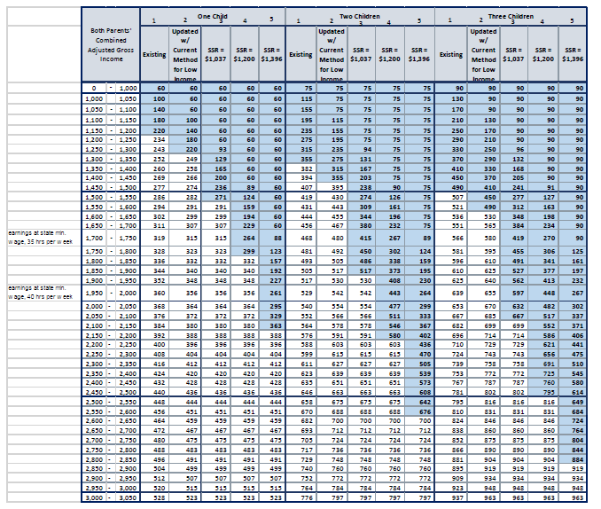
Guideline & Self Support reserve options
If NM reduced income imputation from 40 to 35 hrs. p/wk at current $11.50 per hour = $1,744 per month and CPs income = $0
All examples are orders for 2 children
  Existing: $468/mo (Column 1)
  Updated guidelines w/ low income adjustment: $480/mo (Column 2)
  Updated w/ SSR (@ FPG x price parity)- $1,037: $415/mo (Column 3)
  Updated w/ SSR (in between) - $1,200: $267/mo (Column 4)
  Updated w/ SSR (@ SNAP eligibility) $1,396: $89/mo (Column 5)

Slide 17
Public input

Slide 18
Guideline Commission Recommendations

Slide 19
Commission options for recommendation to HSD
Recommend to make no changes to existing guidelines schedule
Recommend to make no changes to existing guidelines schedule except add shaded area (SSR)– Column 1
Recommend to update guidelines schedule based on economic data and use current method for low-income adjustment – Column 2 (without shaded area)
Recommended to update guidelines schedule based on economic data and add the shaded area – Column 2
Recommend to update guidelines schedule based on economic data and add the shaded area (SSR) at:
  Federal Poverty Guidelines (FPG x price parity) - Column 3
  In between FPG and SNAP Eligibility – Column 4
  At SNAP eligibility – Column 5
Recommend that HSD complete an annual review and of local actual hours worked for purposes of imputing minimum wage as an actual income and ability to pay and adjust accordingly through policy

Slide 20
HSD Legislative Ideas Under discussion
Amend Mandatory Medical Support Act
  Eliminate cash medical support for Medicaid
Allow for Child Support Guideline Schedule, currently by Statute, to be changed through an administrative rule making process.

Slide 21
adjourn

Slide 22
GuidelineSchedule Options

